Slide 1






Conducting An Investigation
A Guide for Food Service Managers

Slide 2


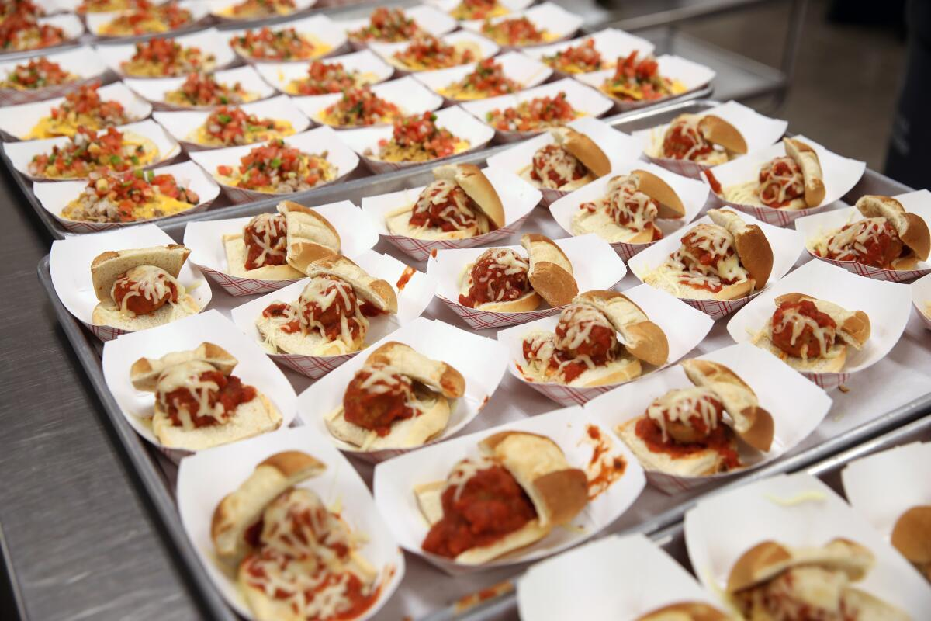
Objective of an Investigation
To gather and collect facts to resolve an issue in a fair and unbiased manner for both employee and manager.

Slide 3


To gather and collect facts to resolve an issue in a fair and unbiased manner for both employee and manager
What to Expect in this Training
Purpose of an Investigation
Investigation Steps
What is an Investigation
Conducting the Interview
When is an Investigation required
Types of Witness Interview Statements
Who to Contact
Investigation Exercise

Slide 4



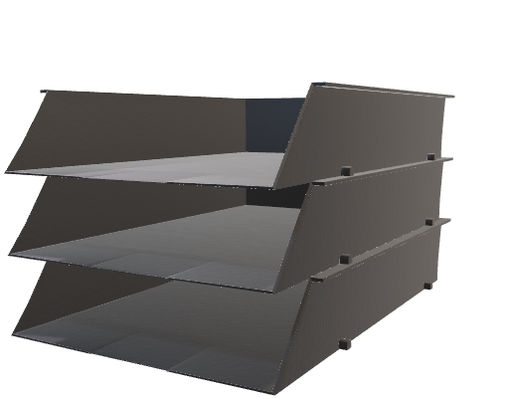
Purpose of an Investigation Training
Assist managers with understanding facts of a cafeteria dispute; determine whether progressive disciplinary action is warranted and identify possible resolutions to conflict.
Collect written statements and gather information

Slide 5
Purpose of an Investigation Training
Assist managers with understanding facts of a cafeteria dispute; determine whether progressive disciplinary action is warranted and identify possible resolutions to conflict.
Interviewing Witnesses
  Direct Witness – Person(s) that were in view of the incident/conflict.
  In-Direct Witness – Person(s) receiving information second hand.

Slide 6
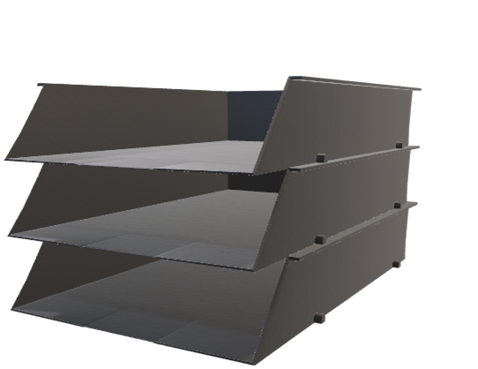



Purpose of an Investigation Training
Assist managers with understanding facts of a cafeteria dispute; determine whether progressive disciplinary action is warranted and identify possible resolutions to conflict.
Submitting all completed documents to Human Resources in a timely manner.

Slide 7


What is an Investigation
An Investigation is defined as:
A formal or systematic examination; when an incident requires clarification regarding employee misconduct.
The Investigation must be Fair and Impartial.
The Investigation must comply with all applicable Federal, State, and Local Laws

Slide 8
When an Investigation is Required
Investigations are required based on the type of complaint(s) where facts are gathered, assessing the situation and determining the appropriate progressive disciplinary action (if necessary).
Anytime a manager receives a complaint, they are required to determine its credibility and of it warrants an investigation.
You may be asked by an AFSS and/or HR Rep to participate in the investigation providing documentation, written statements, or other information.
If managers are unsure of credibility of the complaint, reach out to your AFSS and/or HR Rep.

Slide 9

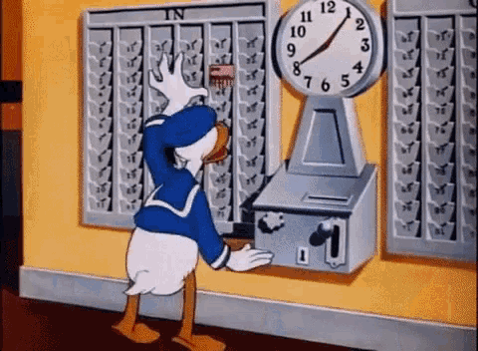
When an Investigation is Required
Here are some examples of when an investigation is warranted:
Timecard Issues
Theft of Property
Discourteous and Inappropriate Conduct
Violations of LAUSD FSD Employee Handbook Policy

Slide 10

Who to Contact
Depending on the complaint or situation, you will contact either your AFSS or your HR Rep.
Area Food Service Supervisor
  Matter/Complaint that is made against you or involves you.
  Complaints that you cannot handle on your own.
  Conflicts between Cafeteria Staff and Other School Employees such as Administrators, Teachers, Plant Managers, and Employees of another school.
Human Resources Representative
  Child Abuse or Neglect.
  Alcohol or Drug related.
  Threats and Workplace Violence.
  Theft related instances.
  Discrimination of any kind.
  Sexual Harassment Allegations.
Note: Complaints must be submitted in writing with a signature and date.

Slide 11

Activity: Who to Contact?
An employee tells you the Plant Manager has been propositioning her using sexual language.
Select the correct answer:
HR Rep
AFSS

Slide 12
Activity: Who to Contact?
An employee has been insubordinate, yelled at other staff, and has ongoing attendance issues.
Select the correct answer:
HR Rep
AFSS

Slide 13
Activity: Who to Contact?
A parent complains her child’s hand was slapped by a FSW during meal service.
Select the correct answer:
HR Rep
AFSS

Slide 14
Activity: Who to Contact?
You smell alcohol on an employee’s breath and her speech is also slurred.
Select the correct answer:
HR Rep
AFSS

Slide 15
Activity: Who to Contact?
A counseled employee says you are racist against Hispanic people.
Select the correct answer:
HR Rep
AFSS

Slide 16
Activity: Who to Contact?
The Principal complains that the cafeteria doesn’t have enough food for all students.
Select the correct answer:
HR Rep
AFSS

Slide 17

Investigation Steps
Ensure Confidentiality
Provide Interim Protection
Selecting Investigator
Create a Plan
To gather and collect facts to resolve an issue in a fair and unbiased manner for both employee and manager
Develop Interview Questions
Conduct Interviews
Determine Decisions
Closure
Written Report

Slide 18

Investigation Steps Explained
Identify the problem.
Look for the root cause.
Review Progressive Discipline Flow Chart for guidance.

Slide 19
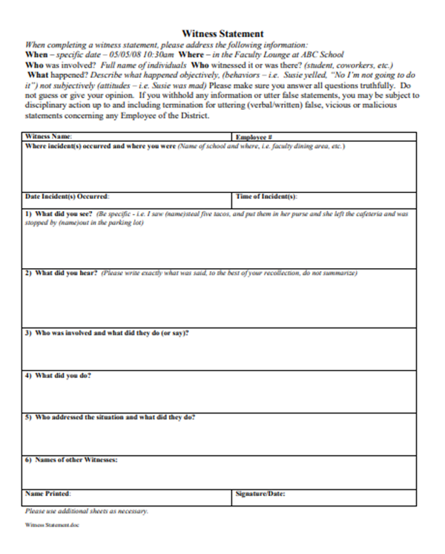
Investigation Steps Explained
Collect witness statements.
Have witnesses begin writing statements immediately using the Witness Statement Form, it must be signed and dated.
Use the 5 “W” & “H” questions.
WHO | was involved, witnessed?
WHAT | happened?
WHEN | did it happen? (time & date)
WHERE | were you?
WHY | did it happen?
HOW | did it happen?

Slide 20



Investigation Steps Explained
Gather all related information for review.
Have all documents related to the investigation.
  Training documents.
  Previous assistance/guidance documents.
  SOP policies/procedures.
  Other documents that may be related.
  Take pictures (when possible).

Slide 21


Investigation Steps Explained
Provide information to HR in a timely manner.
Have all documents related to the investigation.
  Witness statements.
  Training documents.
  Previous assistance/guidance documents.
  SOP policies/procedures.
  Other documents that may be related.
  Take pictures (when possible).

Slide 22
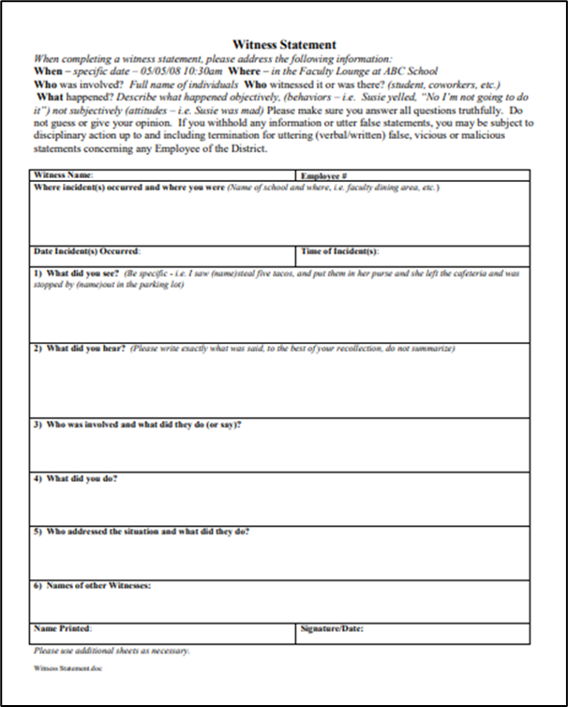
Types of Witnesses
Witnesses are anyone with information that would assist the investigation.
Victim
Accused
  Cafeteria Staff
  Supervision Aide
  Plant Manager
  Faculty
  Students
  3rd Party Personnel
    Delivery Staff
    Visitors to School
Other Parties:

Slide 23


Conducting the Interview
It is important that when conducting an interview, you set the correct tone for people to feel comfortable and confide in you.
Clarify employees understand key phrases before asking questions.
Clear understanding of what constitutes as a threat, violence, sexual harassment, or discrimination.
Once employee understands your frame of reference, ask the question(s).

Slide 24


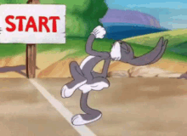
Conducting the Interview
Start with open-ended questions.
Open-ended questions are those that cannot be answered with a yes or no response.

Slide 25
Conducting the Interview
Start with open-ended questions.
Open-ended questions are those that cannot be answered with a yes or no response.
When did you call for additional time?
Did you ask for additional time?
VS
Where do you store the food?
Did you store the food?
VS

Slide 26

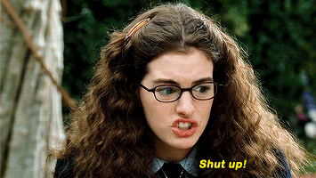
Conducting the Interview
Start with open-ended questions.
Open-ended questions are those that cannot be answered with a yes or no response.
What did you say to Jamie?
Did you tell Jamie to shut up?
VS

Slide 27
Types of Witness Interview Statements
There are two styles of interview statements, Summary Statement versus Transcribed Statement.
Summary Statement is a brief rundown (summary) of a situation that was observed by the employee or person being interviewed.
Transcribed Statement refers to quoting verbatim the reenactments witnessed by the employee or person being interviewed.

Slide 28
Example of a
Summary Statement
Incident: Wilma Witness comes to see you to inform you, as the manager, Larry Late has been falsifying his timecard. You ask Wilma some questions. In this scenario, you are Super Sam AFSS.
Summary Statement is a brief rundown (summary) of a situation that was observed by the employee or person being interviewed.
The following is a summary of the interview between AFSS Super Sam and Wilma Witness on September 4, 2024. On September 3, 2024, Wilma Witness saw Larry Late come to work at 9:40am and write 9:30am on his timecard.
By signing below, I have read the statement above and certify that the statement is correct to the best of my knowledge.
Wilma Witness Date

Slide 29
Example of a Summary Statement
Transcribed Statement refers to quoting the reenactments witnessed by the employee or person being interviewed.
Wilma Witness Interview Date: September 4, 2024
Interviewed by : Super Sam AFSS School: ABC Elementary
Super Sam: What time did you see Larry Late come to work on September 3, 2024?
Wilma Witness: Umm. Err. It was 9:40am. I knew because the BIC kids arrive at 9:40am.
Super Sam: What did he write on his timecard?
Wilma Witness: Well..umm… let’s see. He wrote 9:30am on his timecard.
My signature below indicates that I have read the statement above and certify that they are correct to the best of my recollection.
Wilma Witness Date
Super Sam AFSS (interviewer) Date

Slide 30
Creating an
Investigative Plan
An Investigative Plan is an outline to indicate how to investigate an incident with important details needed.
The Outline:
  What is my objective?
    What are you ultimately attempting to answer?
    Do I need to include upper management, administration, and HR?
  What do I know/need to now?
  What follow-up questions or clarifying questions should I ask?
  Whom do I need to talk to?
    Witness(es)
    Victim(s)
  What supporting information do I need?

Slide 31

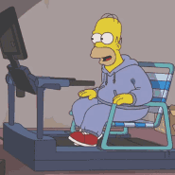
Witness Testimony Exercise

Slide 32
Witness Testimony Exercise
In this exercise you will complete a witness statement. After the allotted time, you will present your witness to the group.
Understand , there is no right or wrong answers.
This is your opportunity to learn how to properly complete a witness statement.
Remember, when you write your statement, include who did or said action(s), what was done/not done, where the incident took place, when did it occur, how did it occur, and why it occurred (if applicable).

Slide 33
Witness Testimony Exercise
Be creative as this is your statement. You can choose from any of the characters within the narrative story or create your own.
Just remember:
WHO | did it happen to?
WHAT | did it happen?
WHERE | did it happen?
WHEN | did it happen?
HOW | did it happen?
WHY | did it happen?

Slide 34
Witness Testimony Exercise
Scenario:
Tattling Dean comes to you on September 4, 2024, says he thinks Senior Ron Upright is taking food home. He says Ron takes food from the storeroom and falsifies the invoices and checklists to cover up the thefts. Ron checks in deliveries.
Tattling says he passed by Ron’s car three times in the past month and saw boxes of what looked like cafeteria order food sitting on the back seat: cans of corn, cans of green beans, and a box of brown sugar. Tattling says the boxes were not open so he could see inside, but he could read what was written on the boxes. At first, he thought Ron was taking home empty boxes until last Wednesday after the delivery. That day he saw Ron pick up a heavy box, put it in the back seat of his car and drove off.
Tattling said he has not mentioned his suspicions to anyone else but last week while you were at training Marsha Moody was mad at Ron and called him a “thief” during an argument. Ron told her she had better not say that again unless she could prove it, or he would sue her for slander. Marsha turned and walked away.

Slide 35


Witness Testimony Exercise

Slide 36
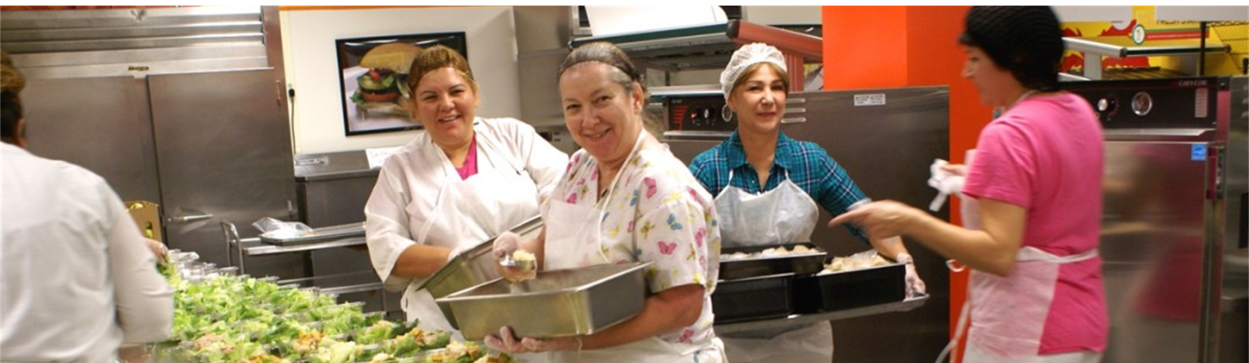


Slide 37
Wrap Up
An Investigative Plan is an outline to indicate how to investigate an incident with important details needed.
Summary:
Identify the problem or issue.
Seek information.
Gather all relevant information and review.
Submit signed witness statements and signed interview statements/notes to HR in a timely manner.

Slide 38

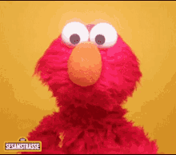

Conducting an Investigation
Any questions about Investigations?

Slide 39



Thank you for all that you do.

